Slide 1
KULTRA MEGA STORES SALES REPORT
Presented by PRAISE VICTOR

Slide 2
1. Background
2. Methodology
3. Analysis
4. Insights
5. Recommendation
TABLE
OF CONTENT

Slide 3
B
A
C
K
G
R
O
U
N
D
Headquartered in LAGOS, Kultra Mega Stores (KMS) specializes in technology, office supplies and furniture. The company's customers range from individual consumers and small businesses (retail) to corporate organizations (wholesale) located in the LAGOS, Nigeria.
The dataset provided contains the company’s order data from 2009-2012.

Slide 4
M
E
T
H
O
D
O
L
O
G
Y
The methodology used in this analysis involved Microsoft Excel for data cleaning. No null or duplicate values were found in this dataset.
After the process of data cleaning, Microsoft Excel’s Pivot Table and Chart were used to visualize the data.
LOOKUP Functions like VLOOKUP was also used to generate specific insights needed for accurate analysis.

Slide 5
A
N
A
L
Y
S
I
S
The purpose of the analysis is to evaluate the sales performance of the store and also to give insights and recommendations to boost the store’s sales.

Slide 6
I
N
S
I
G
H
T
S
The product category with the highest sales is ‘Technology’ recording ₦1,921,183,036 in sales.
The top 3 regions in sales are South South, Lagos and North West recording ₦1,154,957,219; ₦983,413,734 and ₦910,888,269 respectively.
The bottom 3 regions in sales are South West 2, North East and FCT recording ₦313,292,461; ₦257,104,027; and ₦37,361,506 respectively.
Total Sales of ‘Appliances’ in Lagos is ₦64,961,430.
KMS incurred the most shipping cost using Delivery Truck, thereby spending ₦16,685,072.

Slide 7
The most valuable customers are:
Alejandro Grove
Darren Budd
Deborah Brumfield
Emily Phan
Grant Carroll
John Lucas
Julia Barnett
Liz MacKendrick
Roy Skaria
Sylvia Foulston
They all purchased products categorized under Furniture, Office Supplies and Technology.
I
N
S
I
G
H
T
S

Slide 8
I
N
S
I
G
H
T
S
Dennis Kane was the small business customer with the highest sales worth N24,388,635.
The corporate customer who placed the most number of orders was Adam Hart, placing 27 orders from 2009-2012.
Emily Phan was the most profitable consumer customer bringing in profit worth N10,917,108.

Slide 9
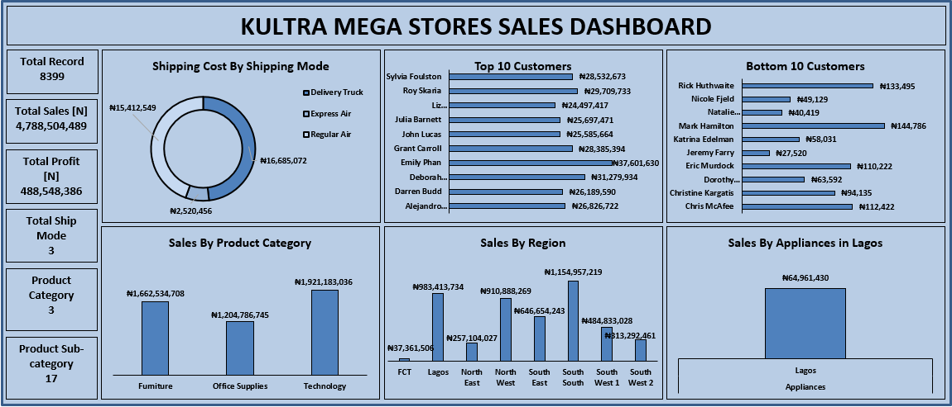
I
N
S
I
G
H
T
S

Slide 10
R
E
C
O
M
M
E
N
D
A
T
I
O
N
To increase the revenue from the bottom customers, the store can:
Cross-sell. For example, the store can offer discounts on office supplies when purchasing appliances in order to encourage customers to add more items to their cart and increase their purchase value.
Offer personalized product recommendations {If the company has the email addresses of these customers, personalized emails can be sent to them regularly showing product suggestions based on their past purchases}.
Offer exclusive deals {like free installation of office supplies, appliances, or furniture after buying goods worth a particular amount}.

Slide 11
R
E
C
O
M
M
E
N
D
A
T
I
O
N
If the Delivery truck was economical but the slowest and Express air was the fastest but most expensive, the company didn't spend shipping costs according to order priority but according to what costs less.
According to the dataset, the orders were classified as either critical, high, low, medium or not specified. However, in each order priority apart from the one not specified, the delivery truck costed more.
If it was the slowest but most economical, the company did not make the right choice because customers value their orders to be treated with urgency. For an order priority to be critical and the company utilizes the slowest means to serve its customers because of the shipping costs, they are at the verge of losing customers. Shipping methods should be carried out based on the urgency of the order. KMS' current approach in shipping is cost-driven and not customer-centric.
My recommendation would be for the company to add the cost of shipping to the price of the products sold if the customers want their orders to be delivered in time. In other words, customers can have dynamic shipping options with conditions. For example, if customers want faster delivery, they know it would cost more based on the shipping option available and the price attached to it.
Also, further analysis can be conducted to know how the shipping speed correlates with customers satisfaction.

